Slide 1



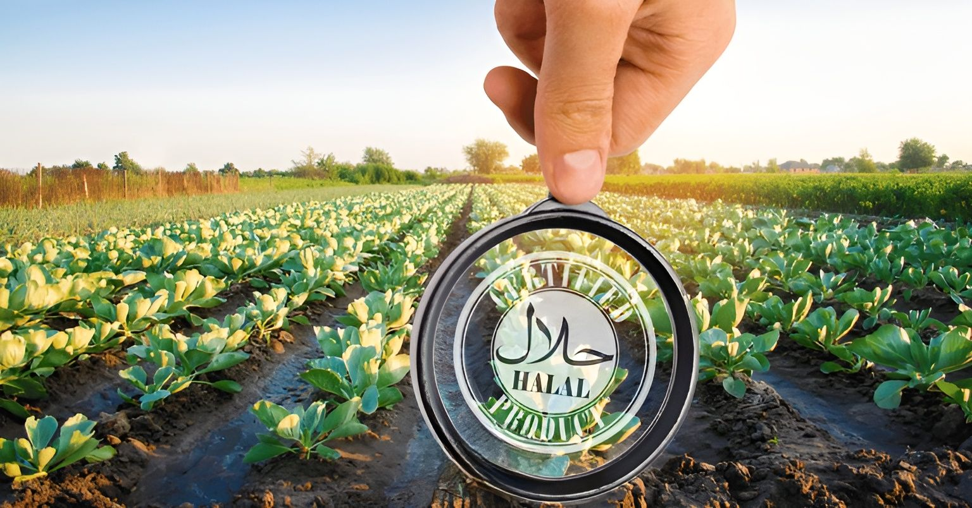

Halal Food Production and Export in Canada
Dr. Brian G. Bedard
https://safegroproject.com/

Slide 2
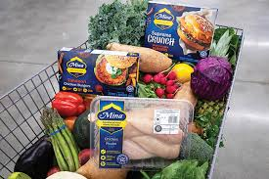
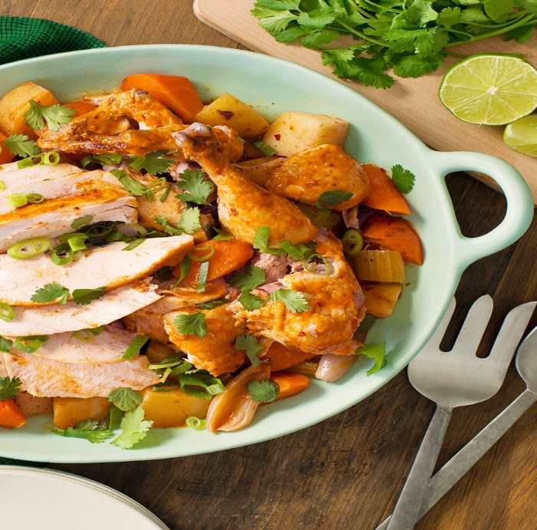
CONTENT - NỘI DUNG
1 Halal Food Market
2 Halal Certification in Canada
3 Consumer Trends and Industry Challenges
4 Global markets
5. Conclusion
Dự án An toàn thực phẩm vì sự phát triển

Slide 3
Food Environment
Notes:
We are in a dynamic global food environment
The way that food is produced and distributed has undergone fundamental changes in recent decades. The food safety landscape has become more complex, driven by widespread changes in methods of food production and processing, coupled with rapid increases in global food trade. These changes have been created by population and income growth in emerging economies and by consumer demands for more diverse and innovative food choices (e.g., ready-to-eat meals). The food processing industry has also become more technologically advanced, significantly increasing the speed and volume of production. At the same time, industry is seeking to remain competitive by developing new products and accessing new markets.
New food safety risks are emerging as a result of globalization and innovation in the food industry; and the ability to detect those risks is improving due to advances in science and technology. Mass distribution networks mean that problems – when they do occur – can quickly become widespread. Recent international incidents of foodborne illness have shown that outbreaks are not necessarily contained within national borders. Food safety regulators rely upon sophisticated technologies and integrated surveillance information to prevent or respond to food safety incidents.
Consumers today are demanding more meaningful information about food safety and quality. The food industry is responding by implementing a range of preventive food safety systems to provide greater assurance that their products meet safety requirements. At the same time, regulators are increasingly being asked by the public to demonstrate that their food safety oversight systems and approaches are effective.

Slide 4
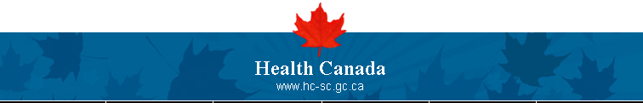
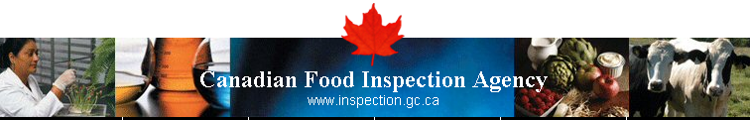

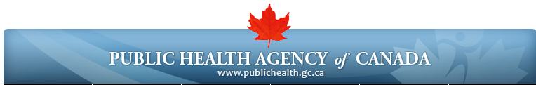
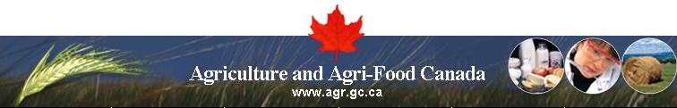
Food Safety in Canada
Food Safety Roles
Notes:
The food industry in Canada (both domestic industry and importers) bears the principal responsibility for food. Consumers must take action at home to keep food safe. Government’s role is to develop the regulations under which safe food is produced and to enforce these regulations.
Responsibility for food safety within the federal government is assigned primarily to three organizations: Health Canada, the Canadian Food Inspection Agency (CFIA) and the Public Health Agency of Canada (PHAC). A fourth organisation, Agriculture and Agri-Food Canada, supports food safety policies through food quality research.
Health Canada establishes policies and standards for the safety and nutritional quality of food sold in Canada. Food policy decisions are based on assessments of risks associated with products or processes from a public health perspective.
The Canadian Food Inspection Agency’s main role is to enforce the food safety and nutritional quality standards set out by Health Canada for domestic and imported products. The Agency delivers inspection programs in food safety and quality, and plant and animal health across Canada, including food processing plants. It also ensures that all food products meet federal packaging and labelling requirements. The Agency takes enforcement action when food safety standards are not met or when health risks are identified. When public safety is threatened, it conducts food investigations and product recalls. In carrying out this role and in fulfilling its responsibility for all federal food inspection activities, CFIA’s objective is to ensure the safety of Canada’s food supply.
The Public Health Agency of Canada plays an active role once an illness caused by food is detected in humans. PHAC supports action in preventing injury and disease across the country, including diseases transmitted by food or animals (foodborne and zoonotic) and to promote national and international public health. In a foodborne illness outbreak, PHAC conducts national public health surveillance and may provide assistance to provincial authorities by contributing to epidemiological studies. PHAC’s laboratories provide reference services to identify and differentiate the various types of micro-organisms involved in the illness as well as systems to assist surveillance and sharing of information.

Slide 5
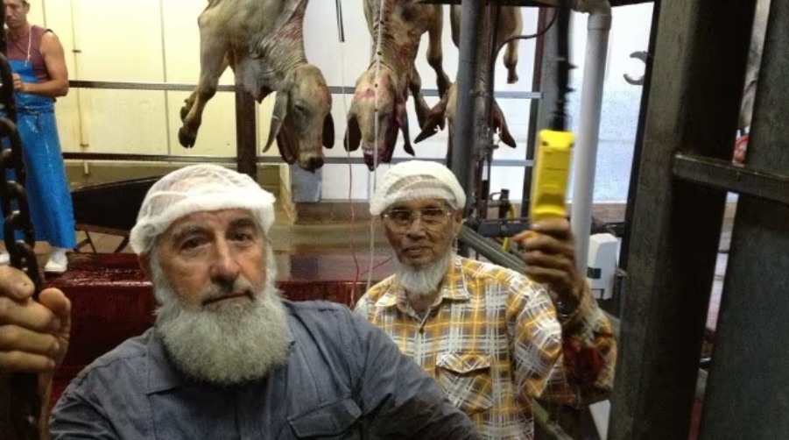
Halal Foods
What Halal Food Includes
Permitted Meats: beef, lamb, chicken, and fish with scales, slaughtered according to Islamic ritual.
Plant-Based Foods: All fruits, vegetables, grains, and other plant-based items, except those that cause intoxication.
Dairy and Eggs: Milk and eggs from permissible animal species are generally halal.
Forbidden (Haram) Foods
Pork: All products derived from pigs are prohibited.
Alcohol: Any amount of alcohol in food is forbidden.
Carrion: Meat from animals that died before slaughtering is not halal.
Blood: The consumption of blood and its by-products is forbidden.
Carnivorous Animals: Like cats and dogs, as well as birds of prey, are not halal.
Halal Slaughter (Dhabihah)
The Animal: The animal must be healthy and free from disease at the time of slaughter.
The Process: A sharp knife - to cut the jugular vein, carotid artery, and trachea, all blood drained from the carcass.
The Prayer: A Muslim must recite a prayer (tasmiya or shahada) to invoke God's name during the process.
Why Halal Food Matters
Religious Observance: Ensures Muslims can fulfill their dietary requirements according to Islamic teachings and the Quran.
Health and Quality: Some consider the halal slaughter process, to be a more humane.
Accessibility: Halal labeling for Muslims to find food options, accessibility

Slide 6
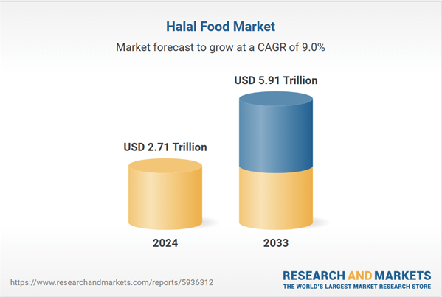
1. Hala Food Market (1/5)
Dự án An toàn thực phẩm vì sự phát triển(SAFEGRO)

Slide 7
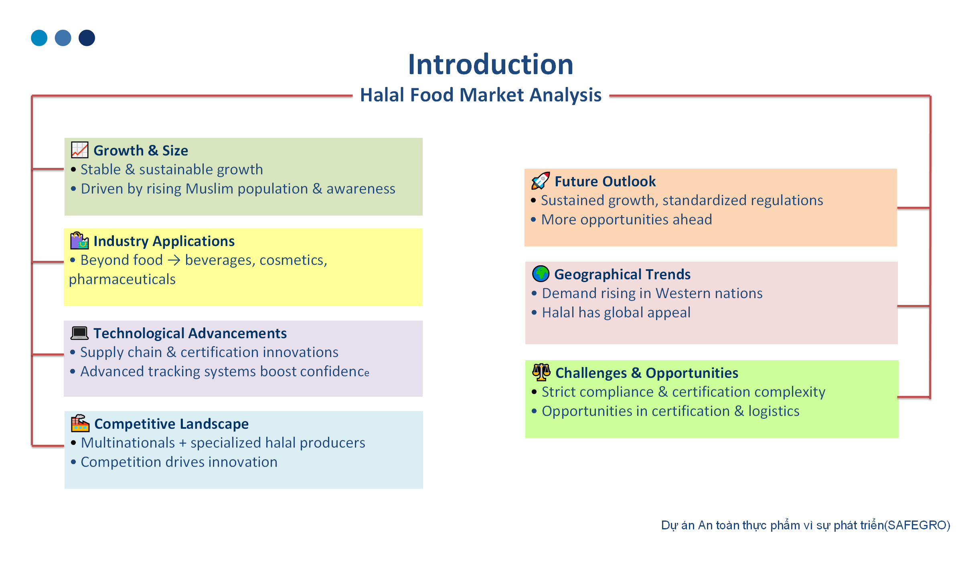

1. Hala Food Market (Continue 2/5)
Introduction
The Canadian Halal Market Landscape
Dự án An toàn thực phẩm vì sự phát triển(SAFEGRO)

Slide 8
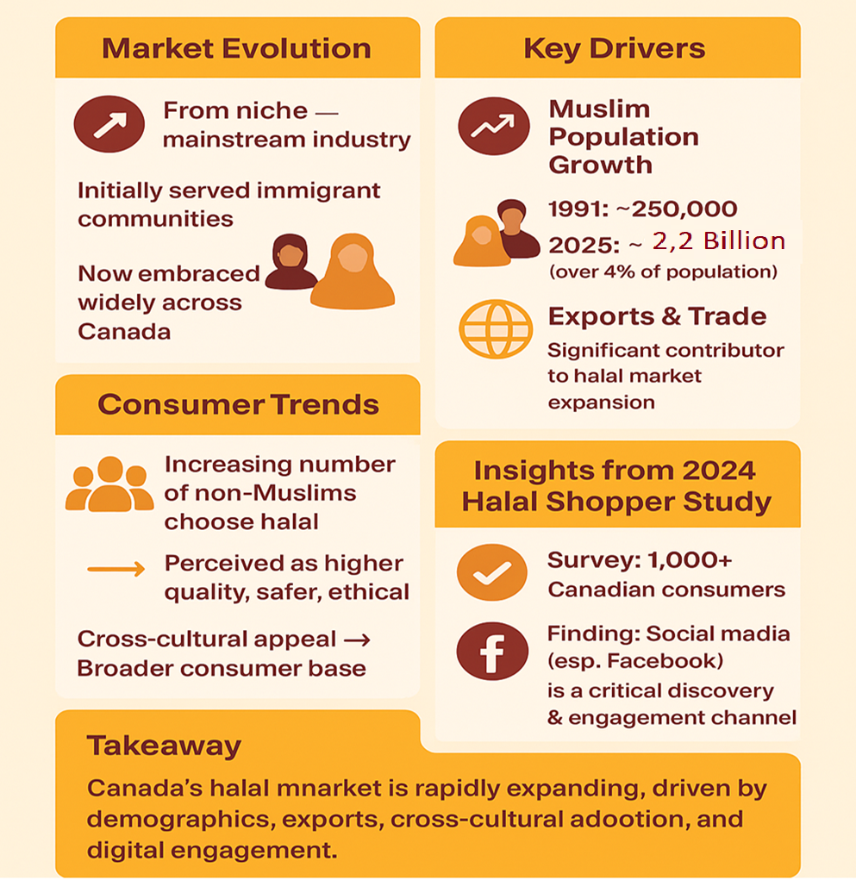

1. Hala Food Market (3/5)
The Canadian Halal Market Landscape

Slide 9
1. Hala Food Market (4/5)
Market Size and Growth
Market Statistic | Value | Year | Source
Canadian Halal Food Market | $2.6 billion CAD | 2023 | The Halal Times. (2025, April 3). How Has Canada’s Halal Food Space Evolved?. Retrieved from https://www.halaltimes.com/how-has-canadas-halal-food-space-evolved/]
Projected Canadian Market | >$4.39 billion USD | 2029 | Canadian Halal Bureau. (2025, May 26). Halal Market Statistics. Retrieved from https://halalbureau.ca/halal-market-statistics/ Canada Halal Food & Beverages Market Overview, 2029 https://www.bonafideresearch.com/product/6208299418/canada-halal-food-and-beverages-market
Global Halal Market | $2.71 trillion USD | 2025 | Canadian Halal Bureau. (2025, May 26). Halal Market Statistics. Retrieved from https://halalbureau.ca/halal-market-statistics/ Halal Food Market Size, Share, Trends and Forecast by Product, Distribution Channel, and Region, 2025-2033. Retrieved 30-September 2025. https://www.researchandmarkets.com/report/halal-food -
Dự án An toàn thực phẩm vì sự phát triển(SAFEGRO)

Slide 10
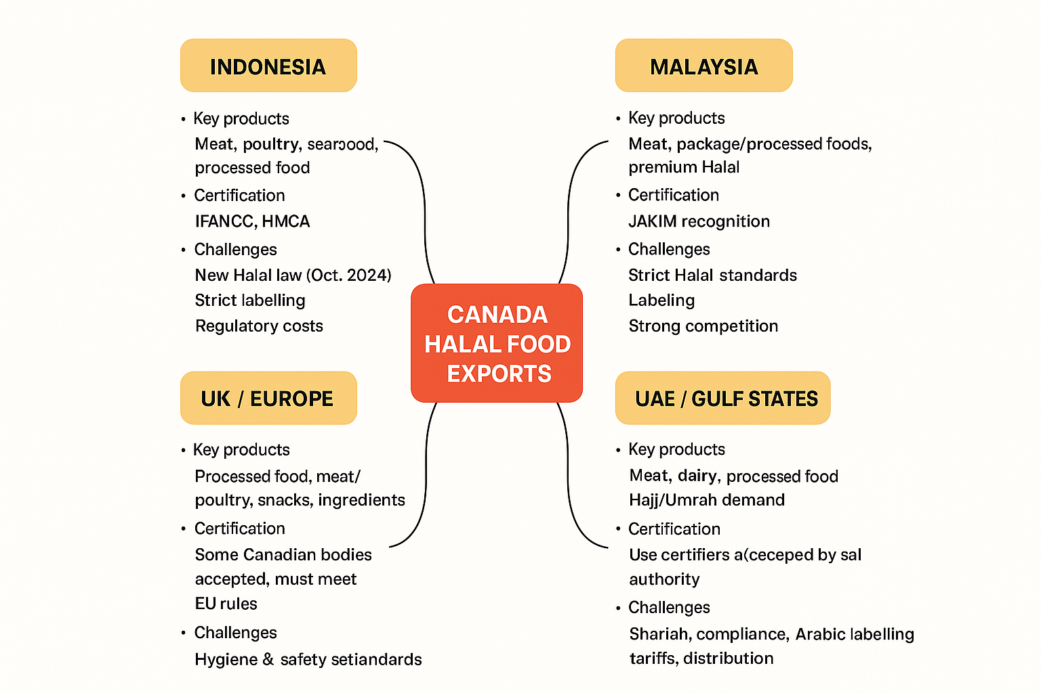
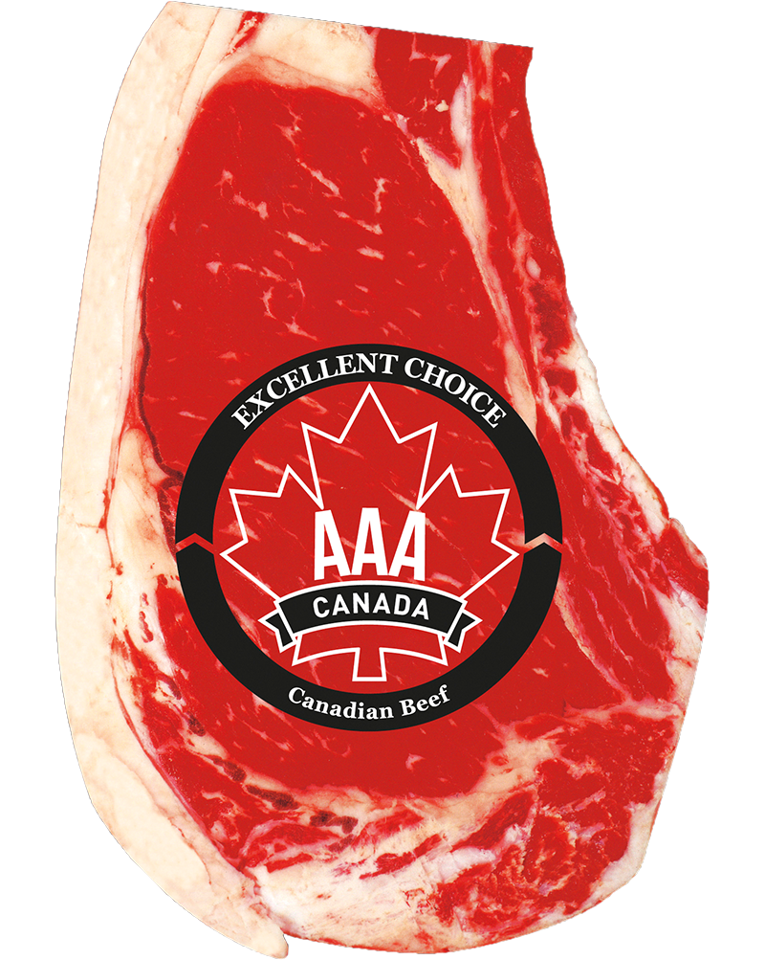
1. Hala Food Market (5/5)
Canada Halal food exports
Canada's Halal Meat Exports to the Middle East Hit $200M in 2024, marking a 50% Surge Since 2020
Dự án An toàn thực phẩm vì sự phát triển(SAFEGRO)

Slide 11
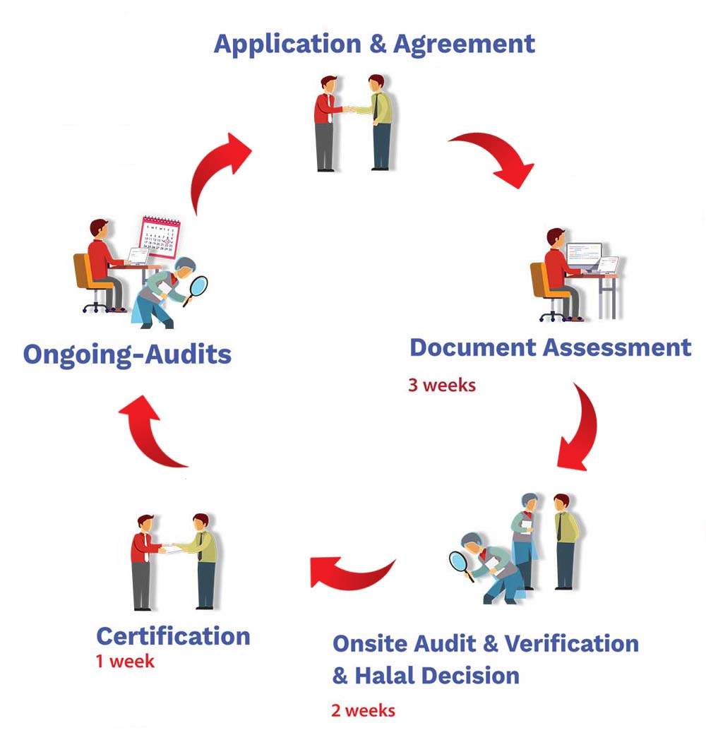
2. Halal Certification in Canada (1/3)
Halal Certification Process
Halal Certification → ensures Islamic compliance
Auditing & Monitoring → entire supply chain
Compliance with Islamic Law
proper slaughter
Auditing & Inspection
facilities comply, ingredients, processes
Continuous Monitoring
maintain standards post-certification audit
Product Labeling
certifier’s logo for consumer assurance
https://halalcs.ca/halal-process/
Dự án An toàn thực phẩm vì sự phát triển(SAFEGRO)

Slide 12

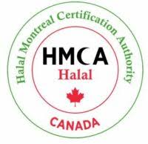
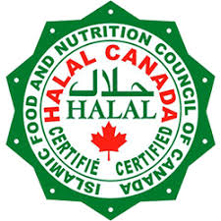
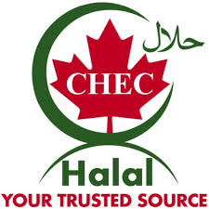

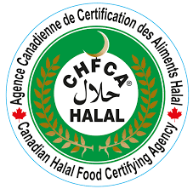

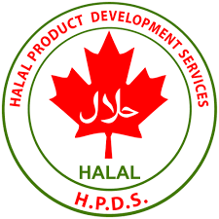
2. Halal Certification in Canada (2/3)
Key Halal Certification Bodies
ISNA Halal Certification Services (ISNAHCS)
Halal Montreal Certification Authority (HMCA)
Halal Monitoring Authority (HMA)
The Islamic Food and Nutrition Council of Canada (IFANCC)
Canada Halal EC
Canadian Halal Food Certifying Agency (CHFCA)
Halal Advisory Group (HAG)
Halal Montreal Certification Authority (HMCA)
Dự án An toàn thực phẩm vì sự phát triển(SAFEGRO)

Slide 13
2. Halal Certification in Canada (3/3)
Canadian Government → regulates halal industry
Consumer Protection → ensures safety & compliance
Market Access → facilitates trade and growth
Canadian Food Inspection Agency (CFIA)
CFIA Halal Labeling Regulation:
- Mandatory Certification → all halal-labeled products must be certified
- Certified Body Name → must appear on label, packaging, or ads
- Government Oversight → prevents fraudulent claims
Ritual Slaughter in Canada
Legal Framework → SFCA & SFCR (2019)
Ritual Slaughter Permitted → halal & kosher
Animal Welfare → humane treatment prioritized
Regulatory Flexibility → allows ritual cut before unconsciousness
Stunning → encouraged but not mandatory for ritual slaughter
Dự án An toàn thực phẩm vì sự phát triển(SAFEGRO)

Slide 14
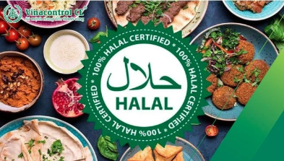
3. Evolving Halal Consumer Preferences (1/2)
Product Diversification → beyond meat: baked goods, snacks, beverages, candy
Online Shopping → 60% use online grocery services
Social Media Influence → Facebook drives product discovery & recommendations
Modern Tastes → younger consumers want halal + lifestyle-friendly options (e.g., gummy candies, ready-to-eat meals)
Dự án An toàn thực phẩm vì sự phát triển(SAFEGRO)

Slide 15
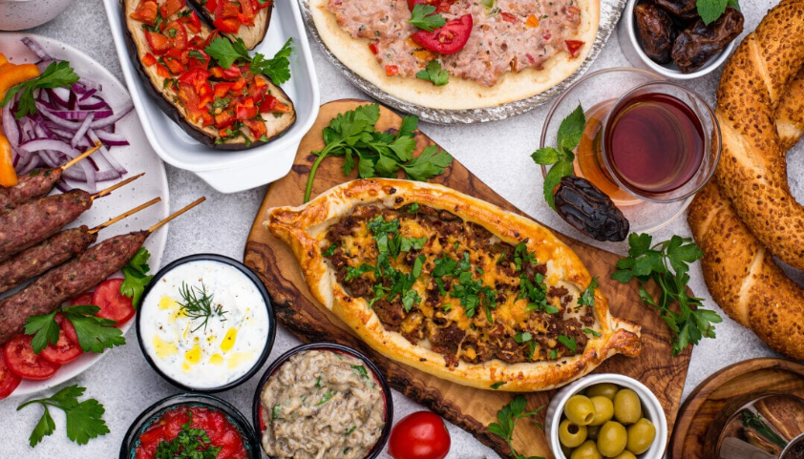
3. Evolving Halal Consumer Preferences (2/2)
Industry Challenges
Fragmented Certification
Multiple certifiers & standards → confusion
Supply Chain Integrity → cross-contamination risks at every stage
Labeling & Fraud → mislabeled/contaminated products; need strong monitoring:
Ingredient Fraud → hidden animal derivatives, porcine enzymes, glycerin
Process Risks → shared lines, poor segregation, inconsistent cleaning
Documentation Issues: expired/misrepresented certificates, recertification delays
Consumer Misrepresentation → false halal claims → reputational damage
Regulatory Compliance → misleading halal claims can trigger CFIA action
Unauthorized Facilities → unlicensed slaughter & prep
Certification Mismatch → valid certification/lapsed facility license
Dự án An toàn thực phẩm vì sự phát triển(SAFEGRO)

Slide 16
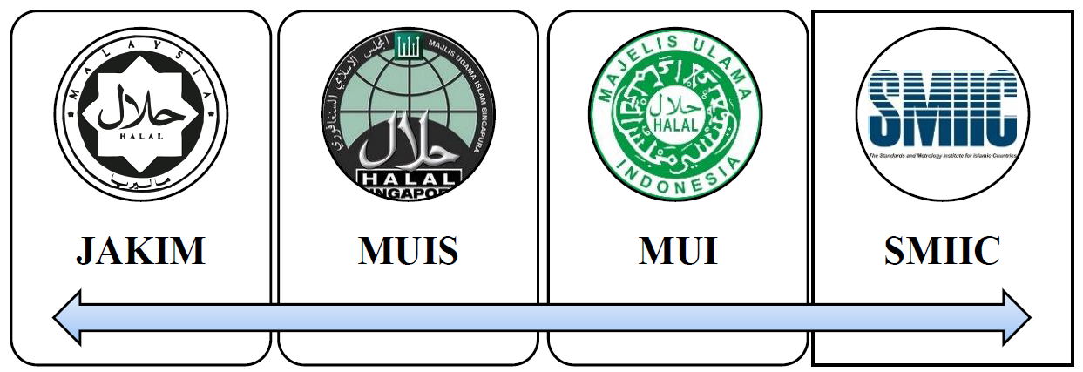
Halal Certification Standards
4. The Broader Halal Economy (1/3)
International halal standards
Halal Standard by SMIIC
Malaysia Halal Standard
Halal Standard of Indonesia
Halal Standard of Singapore
National compliance standard
1) Rules of slaughtering
2) Food processing
3) Machinery, utensils, and production lines
4) Storage, display, service and transport
5) Hygiene, sanitation, and food safety
6) Validation and verification
7) Identification and traceability
8) Presentation for the market (packaging/labelling)
9) Legal requirements, and others
National Halal Standards
New Zealand (1970)
Singapore (1972)
Saudi Arabia (1972)
International Islamic Halal Organization (IIHO)
South Africa (1975)
Australia (1977)
USA & Brazil (1980)
Malaysia (1981)
Indonesia (1986)
100s ++++++++++++++

Slide 17
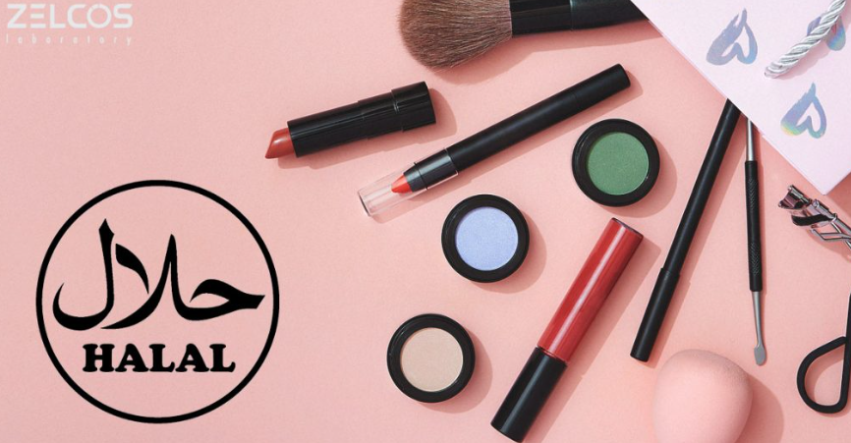
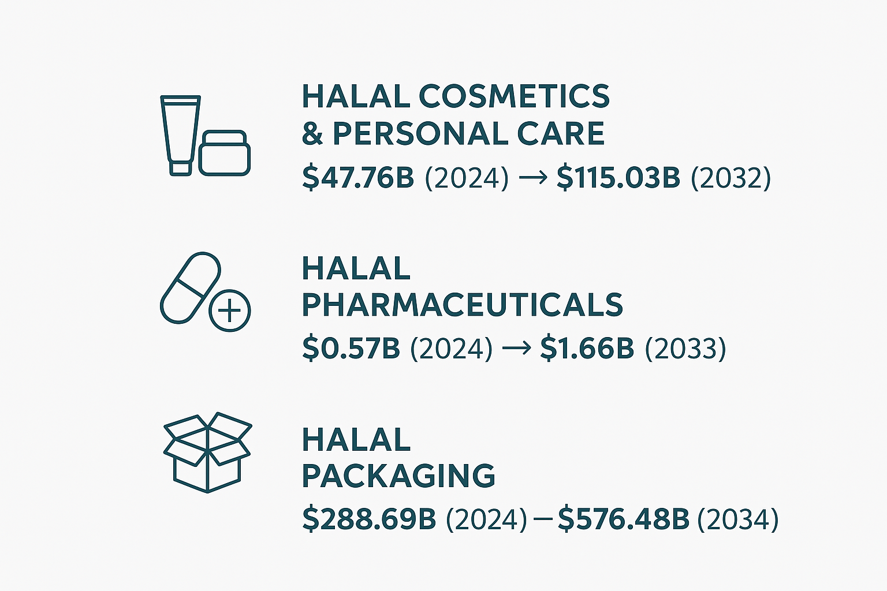

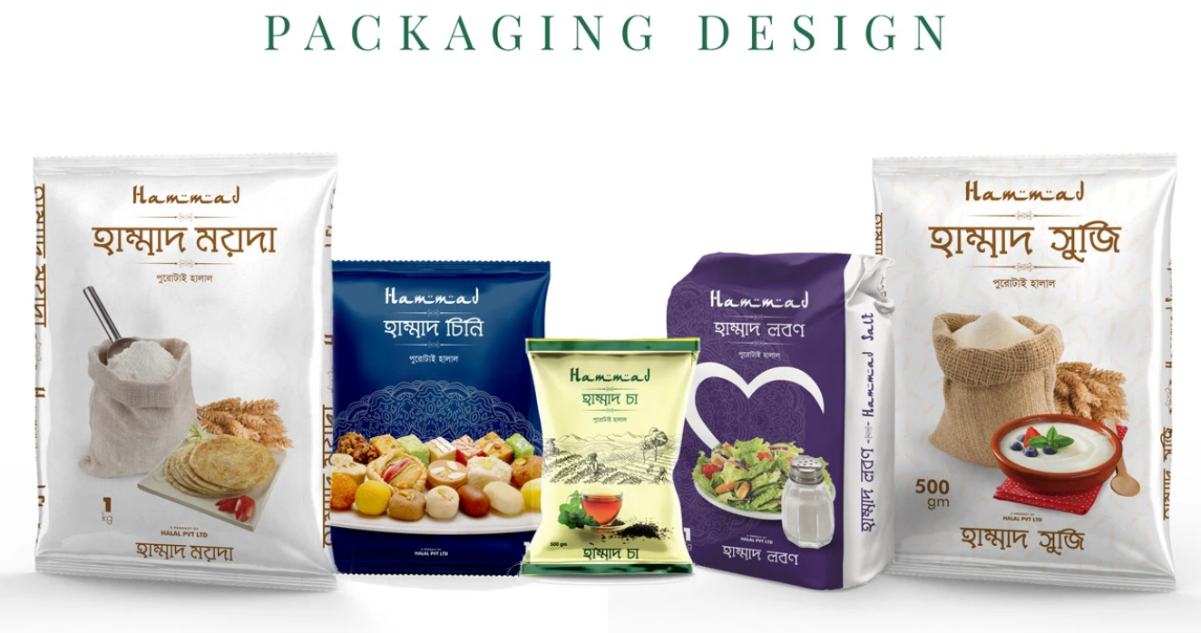
4. The Broader Halal Economy (2/3)
Dự án An toàn thực phẩm vì sự phát triển(SAFEGRO)

Slide 18

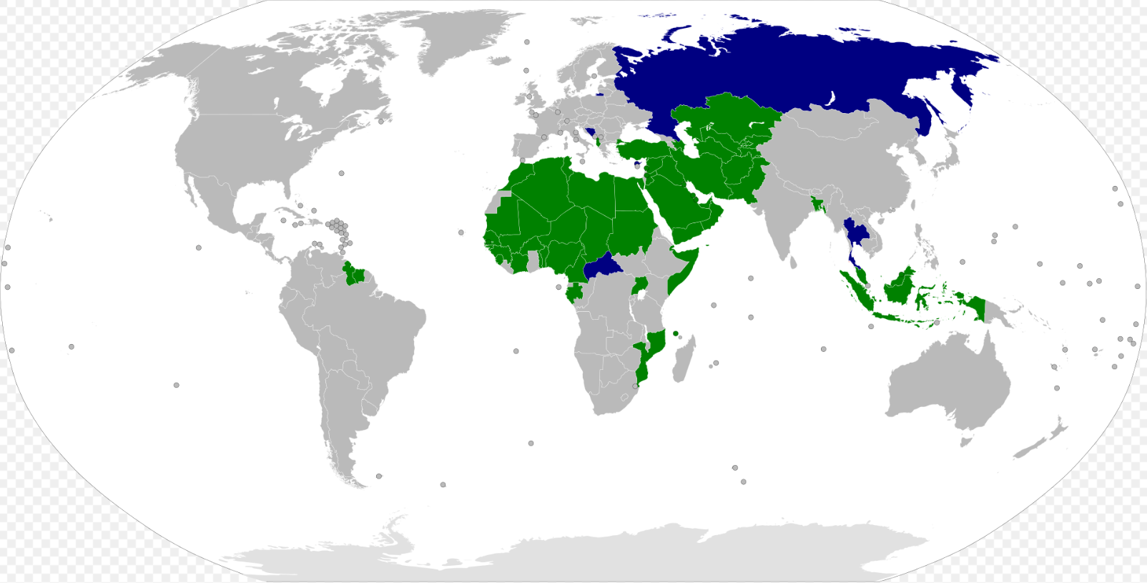
Organization of Islamic Cooperation (OIC)

Slide 19
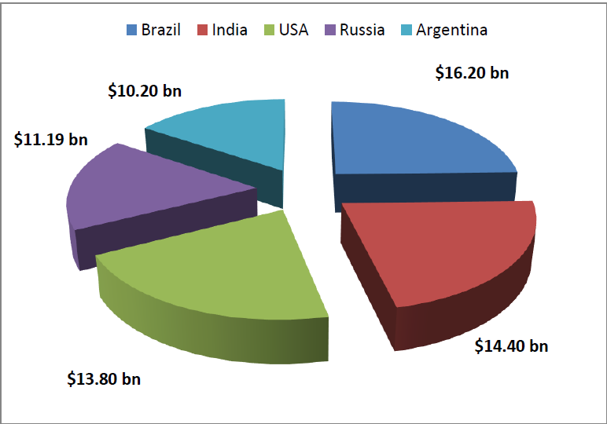
4. The Broader Halal Economy (3/3)
Sales to OIC

Slide 20
Canadian Halal Industry
Vibrant & Growing → rapidly expanding sector with strong foundation
Engaged Consumer Base → increasing demand & evolving preferences
Supportive Regulations → facilitates market growth
Product & Service Diversity → wider range beyond traditional offerings
Challenges → certification fragmentation, supply chain integrity
Opportunity → businesses navigating complexities can thrive in dynamic market
Dự án An toàn thực phẩm vì sự phát triển(SAFEGRO)

Slide 21
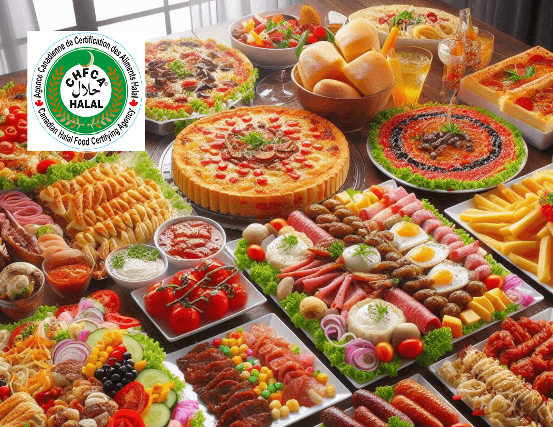
Dự án An toàn thực phẩm vì sự phát triển(SAFEGRO)

